Slide 1
Signal‑to‑Storage: Early Warning Forecasts for FTES Charging Operations
Sub-Terra Tensor Tinkerers
Theresa Pham
Xi Tan
Mike Parker
Scott Unger
Julian Chesnutt
Ashton Kirol

Slide 2
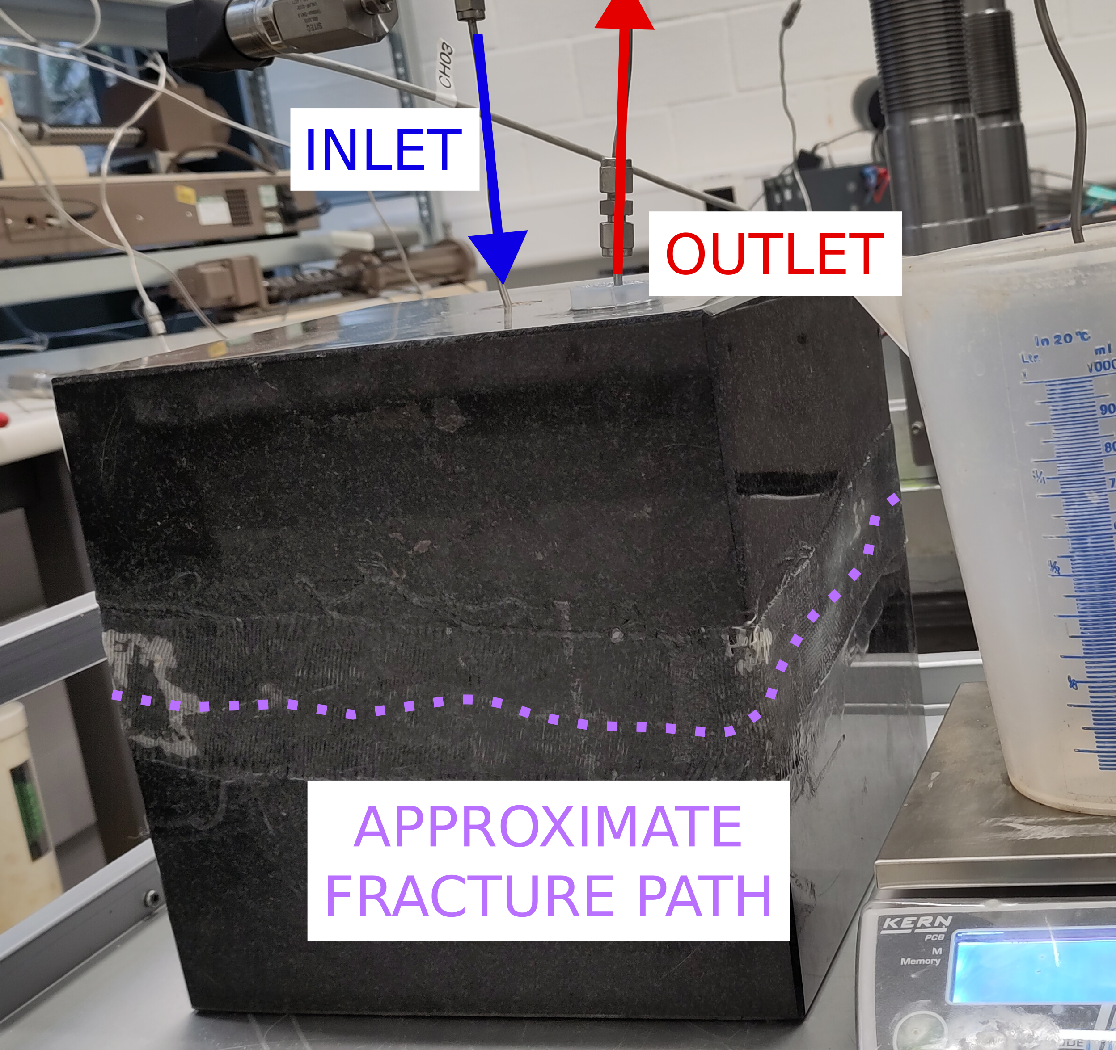
Project Overview and Metrics for Success
Problem
Detect pump-limit pressure escalation or major thermal-output changes with one hour of advance Maintain reliable and consistent model performance across multiple operating modes
Success Criteria
Develop a causal, short-horizon forecasting model that predicts TC-well injection interval pressure, as well as TN/TL-well production temperature and flow during hot-water injection and ambient-water recirculation operations Provide early warning of pump-limit pressure escalation and shifts in recoverable thermal output
Goal
Fracture Thermal Energy Storage (FTES) stores heat underground by injecting warm water into subsurface rock and recovering it through nearby production wells. Effective operation requires forecasting rising injection pressures and changes in produced water temperature and flow, which impact heat recovery
Lab-scale fracture thermal energy storage experiment (Burghardt et al., 2026)
Notes:
Notes: The problem we addressed is [problem], which leads to [impact]. Our goal was to build a model that can [task]. We defined success using [metric], while also ensuring results were consistent and comparable across ML and LLM approaches.

Slide 3

Dataset
Source: DEMO-FTES Test 1 telemetry dataset from the Sanford Underground Research Facility (SURF)¹ Size: Hour-resolution multivariate time-series records collected during test operations. Features: Water flow, pressure, temperature, and electrical conductivity from injection and production wells.
Challenges
Missing or inconsistent sensor values may require cleaning and interpolation Bias toward a single site and specific operating conditions may limit broader applicability Limited edge-case coverage for rare pressure spikes, equipment interruptions, or unusual flow behavior
Data Overview & Challenges
¹Burghardt, J., Hibbard, L., & Sirota, D. (2025). DEMO-FTES Test 1: Water Flow, Pressure, Temperature, and Electrical Conductivity Data. [Data set]. Geothermal Data Repository. Pacific Northwest National Laboratory. https://gdr.openei.org/submissions/1730
Notes:
Notes: We used [dataset], which includes [key features]. However, we encountered challenges such as missing values and potential bias in [area]. These issues directly influenced how we prepared the data and selected our models.

Slide 4
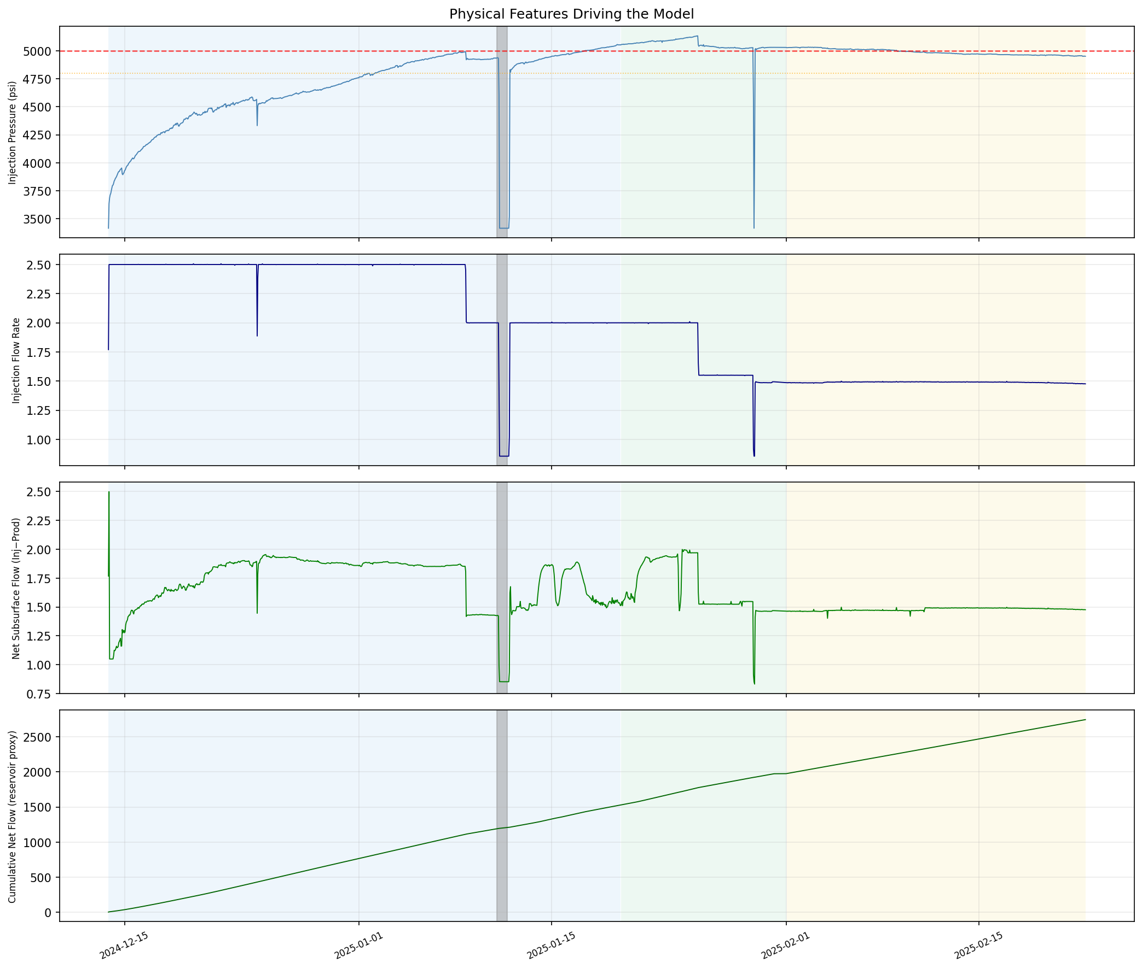
Data Overview & Challenges​ Hot Water Injection Phase
Injection Well Pressure (psi)
[Target Feature]
Training
Testing
Validation
Injection Flow (L/min)
Net Flow (L/min)
[Injection –Production]
Notes:
Hot water injection phase (only a portion of the field data, but when sensors show variability).
Color shading indicates Train, Test, Validation split
Note different operational regime for each phase (trouble splitting data). Testing/Validation outside training magnitude.
Little injection variation (few step reductions)
Single operational test (near constant rising pressure) so we couldn't train on one injection period and test on another. We split a single continuous field test.
~5,000 psi is the threshold where they reduce flow

Slide 5
Model Selection
 | Kalman Filter | XGBoost (eXtreme Gradient Boosting) | LSTM (Long Short-Term Memory)
Description | Recursive state-space algorithm rooted in Bayesian statistics. | Supervised ML using ensembles of decision trees, framing the problem as regression. | Recurrent Neural Network designed for sequential data.
Strengths | Computationally lightweight Interpretability Dynamic model – real-time forecasting | Efficiency Captures nonlinearities Ideal for high-dimensional, tabular data | Specialized for long-range dependencies Captures nonlinear temporal effects Learns features
Limitations | Possible underfitting of complex nonlinear patterns | Struggles with temporal dependencies – feature engineering required | Overfitting risk Higher compute Lower interpretability
Notes:
Left -> right increases in model complexity
Kalman filter serves as principled classical reference point to evaluate whether machine learning models offer genuine predictive improvements for this short-horizon forecasting task.

Slide 6
Approach Overview – Feature Selection
Kalman Filter | XGBoost and LSTM | LLM (Gemma 3) | Note
Injection Pressure | Injection Pressure | Injection Pressure | Target
↑ /↓ 5,000 PSI Threshold | ↑ /↓ 5,000 PSI Threshold | ↑ /↓ 5,000 PSI Threshold | Classification Target
Injection Flow | Injection Flow | Injection Flow | Operational Input
Net Flow | Net Flow | Net Flow | Engineered
Cumulative Flow | Cumulative Flow | Cumulative Flow | Engineered
 | Pressure acceleration (d²P/dt²) | Pressure acceleration (d²P/dt²) | Engineered
 | Pressure rolling mean and std | Pressure rolling mean and std | Engineered
 | Net Flow rate of change | Net Flow rate of change | Engineered
 | Distance to threshold (headroom) | Distance to threshold (headroom) | Engineered
 | Fraction of threshold reached | Fraction of threshold reached | Engineered
 |  | Regime Label | Engineered
 |  | Calculated Crossing Likelihood Label | Engineered
Wellbore friction pressure component |  |  | KF Hidden State (estimated)
Rate of reservoir pressure change |  |  | KF Hidden State (estimated)
Notes:
We did some prediction of pressure values. Largely switched to pressure threshold prediction (above or below 5,000 PSI)
Simple input features for Kalman filter
Additional engineered features (lag, rate of change, distance to pressure threshold) for XGB and LSTM
Calculated regime labels for LLM (more success than relying on LLM arithmetic)
These includes bins for distance to threshold (close vs far) and crossing likelihood based on rate of change and distance. Affects confidence.
Example: rising_soon : Below alert, but threshold reachable within 24h at current rate : Above likely at +12h and +24h

Slide 7
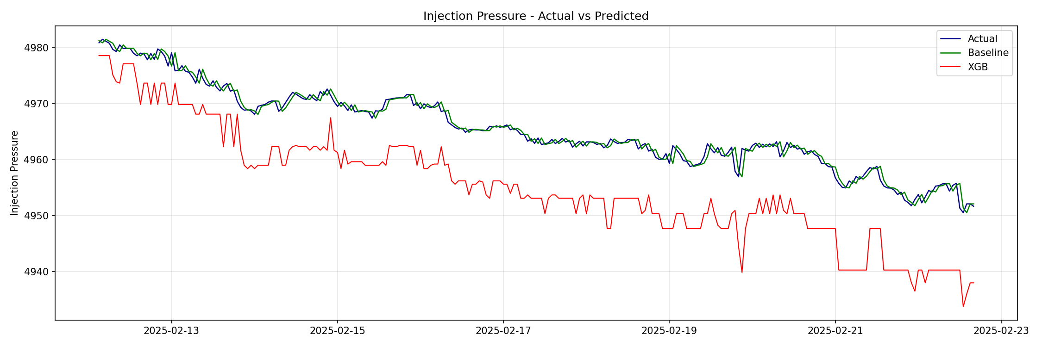
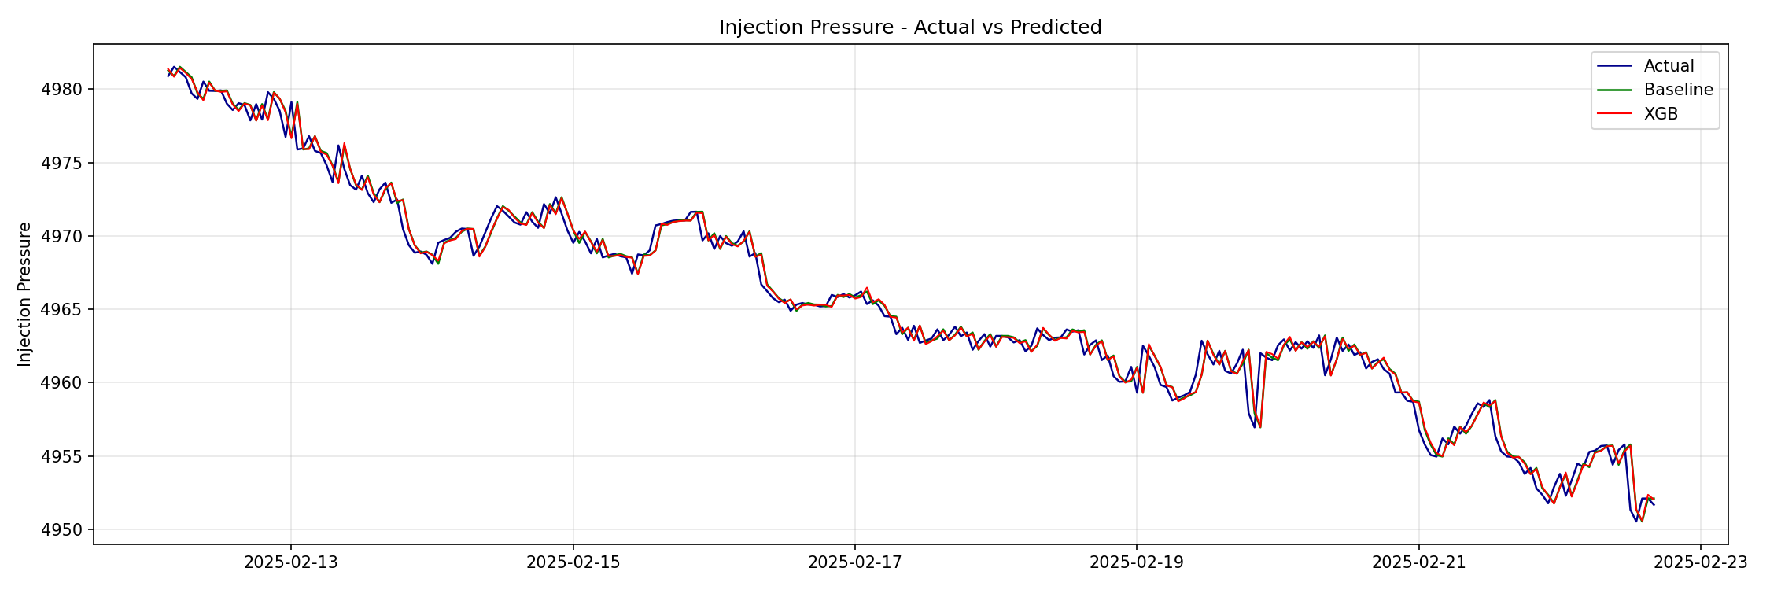
Initial ML Results & Insights – XGBoost Test Set
Approach 1:
Predict raw injection pressure values as the target
Approach 2:
Predict change in injection pressure at each 1h timestep
Notes:
Only test set is shown, but model was trained on much lower injection pressure values.
Approach 1 overshoots changes, approach 2 matches baseline (learning to predict no change to minimize error)
Both XGBoost approaches not ideal

Slide 8
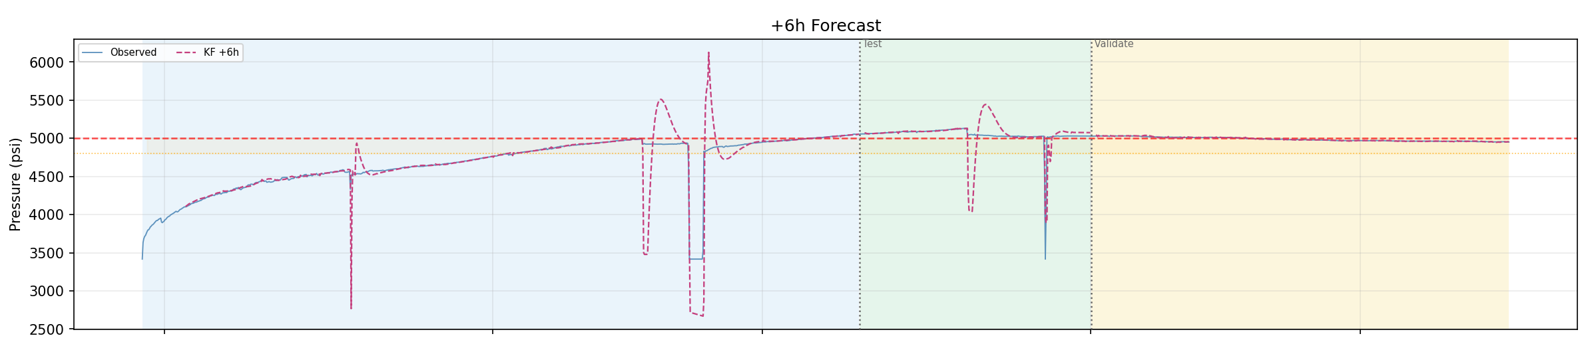
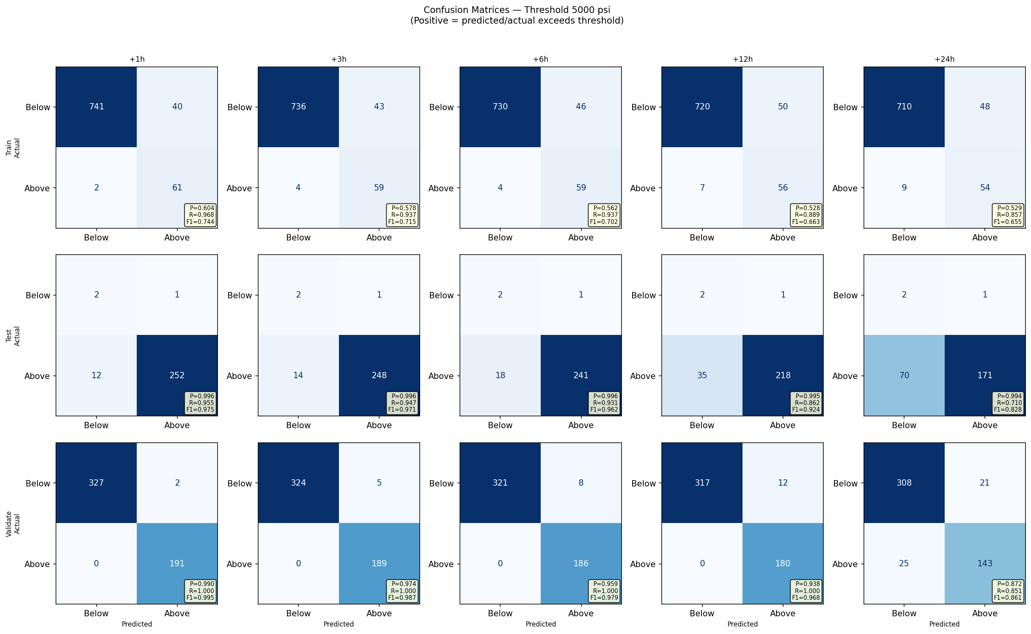
ML Results & Insights - Kalman Filter
Approach 3:
Classify when pressure exceeds 5,000 psi from prediction.
Pressure Prediction:
Pressure Threshold Classification:
+1hr
+3hr
+6hr
+12hr
+24hr
Notes:
Kalman Filter. + 6hr forecast shown. Note accurate timing, but inaccurate magnitude.
Model "overreacts" to changes in flow
Switch to threshold detection as target – high accuracy.
No false negatives within 12 hour forecast.
Confusion matrix note:
Y axis = actual value
X axis = predicted
Top left and bottom right = correct
Bottom left = false negative (predicts below when truly above)
Top right = false positive (predicts above when truly below)

Slide 9
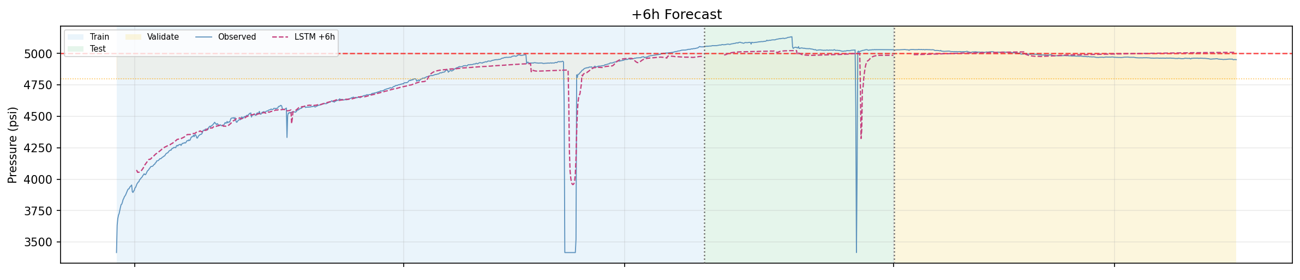
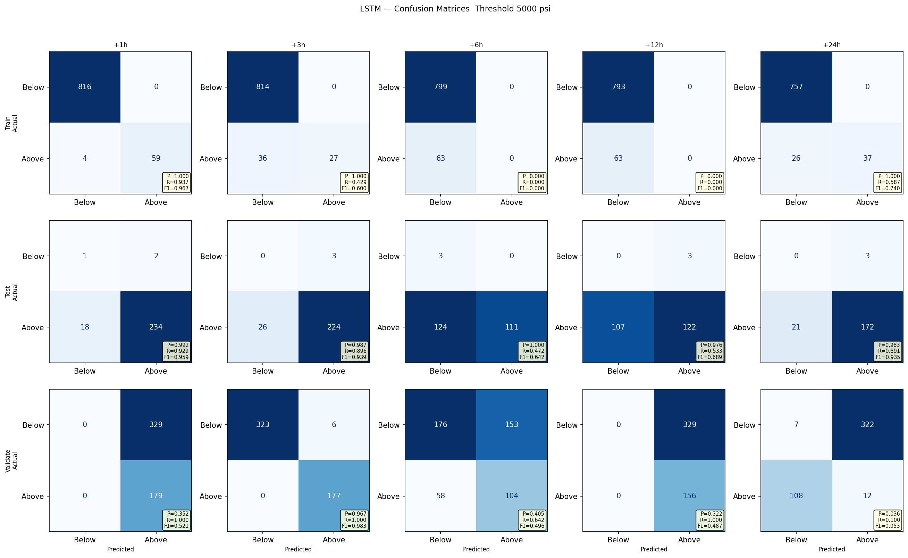
ML Results & Insights - LSTM
Pressure Prediction:
Pressure Threshold Classification:
+1hr
+3hr
+6hr
+12hr
+24hr
Notes:
LSTM + 6hr forecast shown. Similar results to XGBoost
Better pressure accuracy, worse threshold classification.
Some struggle with timing (peaks/dips delayed)
Very mixed results in classification confusion matrix. (near perfect 3 hr, always predicted above at 1 hr and 12 hr, almost always wrong at 12hr)
Confusion matrix note:
Y axis = actual value
X axis = predicted
Top left and bottom right = correct
Bottom left = false negative (predicts below when truly above)
Top right = false positive (predicts above when truly below)

Slide 10
LLM Approach & Results - Gemma3
Approach
Total Tokens: ~1,300 (Standard context window, Fairly large prompt)
Switched to deterministic prompt architecture; Maps raw sensor data to six defined pressure regimes (headroom and stability).
Complexity: Medium (Requires the model to balance contradictory features like rising pressure vs. active flow reduction).
Started by predicting raw pressure
Structured JSON output
Strategy
Final Architecture
Stratified few-shot examples to anchor the model’s confidence scoring across varying levels of pressure volatility.
Rule-Based Optimization: Implementing explicit decision logic and confidence-weighting increased classification accuracy by >50% compared to first attempts.
Notes:
Notes: We then used an LLM to perform the same task.We designed prompts with structured outputs and used few-shot examples to improve consistency.The LLM achieved [metric] of [value].It handled flexible inputs well, but we observed issues like inconsistent formatting and hallucinations.

Slide 11
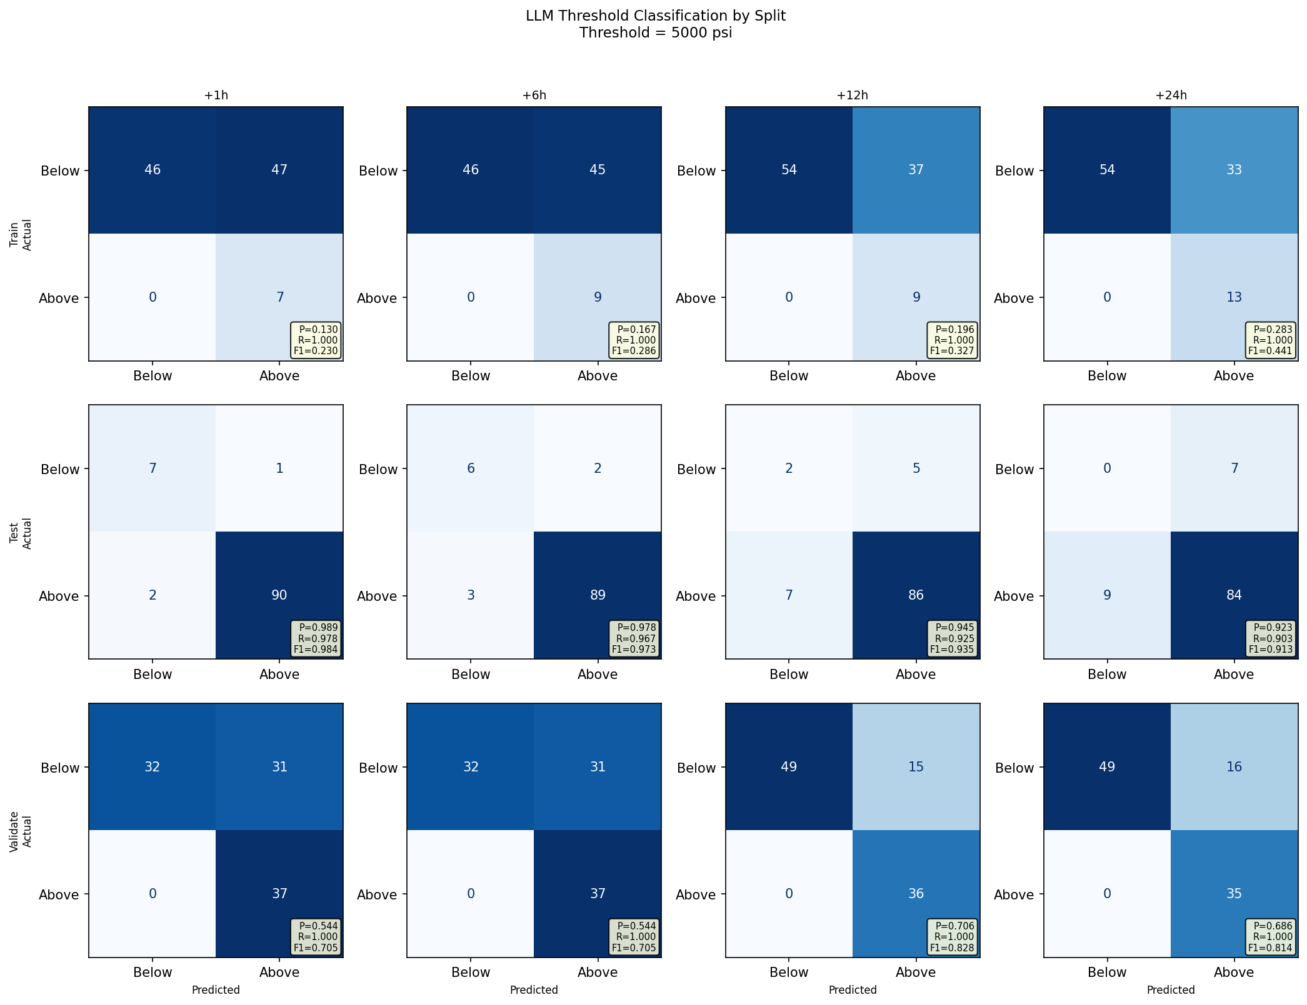
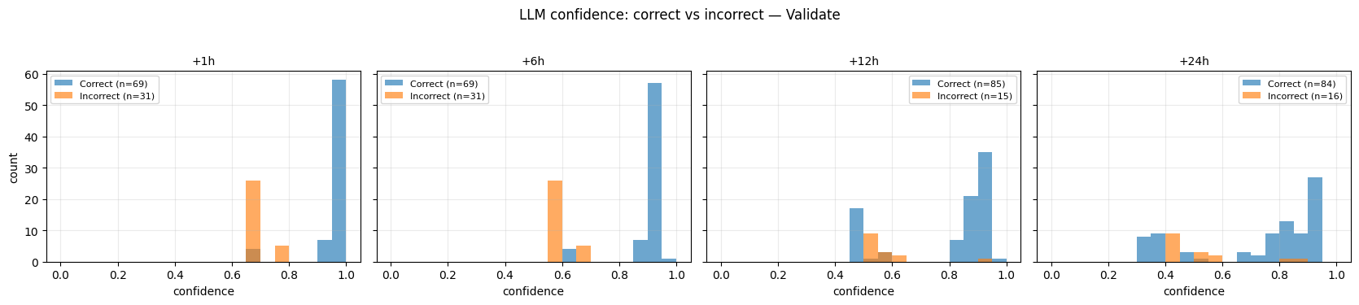
LLM Approach & Results - Gemma3
Pressure Threshold Classification:
+1hr
+6hr
+12hr
+24hr
Notes:
No false negatives. Up to 50% false positives. Model often predicts 'above' but never misses threshold crossing.
Better predictions at longer (12, 24 hr) forecast horizons.
Most incorrect predictions have lower confidence than correct predictions, so fine tuning this metric as part of the prediction would increase accuracy.

Slide 12
ML vs LLM Comparison
= Best performing method(s)
Criteria | Kalman Filter | XGBoost | LSTM | LLM
Pressure MAE | 4 - 116 psi | 57 - 87 psi | 42 - 66 psi | N/A
Threshold F1 | 0.94 | 0.42 | 0.51 | 0.70
Threshold Recall | 0.97 | 0.79 | 0.95 | 1.00
Threshold Precision | 0.95 | 0.42 | 0.41 | 0.56
Consistency across horizons | High | Low — collapses at +24h and in Validate | Low — unstable, near-zero at some horizons | Medium — recall stable, precision variable
Generalization to new regime | Good — trend extrapolation matches Validate | Poor — hard extrapolation boundary | Poor — inconsistent outside training distribution | Good – if threshold and metrics are defined
Speed | Fast | Fast | Moderate | Slow
Setup effort | Low to Medium — physical model design, few hyperparameters | Medium — feature engineering + tuning | High — architecture, training, instability | Low to medium— prompt engineering only (can vary)
Flexibility | Moderate to high — paramaters transferrable | Moderate — retraining required for new regime | Moderate — retraining required | High — prompt adjustable without retraining. More complicated inputs.
Interpretability | High — physical state decomposition | Low - medium | Low | High — reasoning visible in prompt/output
* values represent an average of 1 to 24 hour forecast horizons
Notes:
Notes: F1 = 2 × (Precision × Recall) / (Precision + Recall)
Kalman filter simplest model and most accurate at predicting threshold, largely interpretable. Success could be artificial because of regime during validation. MAE artificially low because validate didn't have much variability. MAE was very large in test set.
XGBoost and LSTM severely hurt by different operational regimes (poor transferability between train/test/validate) but still most accurate pressure values in test set.
LLM required most inputs/engineered classification to improve accuracy. Best recall but conservative (many false positives). Obvious areas for model improvement with new versions.
Even though XGBoost and LSTM generally performed worse, they looked promising for extending to other predictions (flow, temperature of production wells) with more training regimes.
** Some of these are highly subjective. I didn't time anything.

Slide 13
Insights & Closing
Key Insights
Collect more data (if possible) to capture long-term trends and seasonal/cyclical patterns
Future Work
Chronologic data split with disparate training and testing data Short timespan (December 2024 – February 2025)
Problem framing – turning the objective to predict above/below a threshold improved performance and interpretability Statistical approach outperformed modern models
Limitations
Expand analyses to different well locations, depths, and experimental phases
Test viability of using the full, 1-second resolution dataset
Notes:
Notes: The problem we addressed is [problem], which leads to [impact]. Our goal was to build a model that can [task]. We defined success using [metric], while also ensuring results were consistent and comparable across ML and LLM approaches.

Slide 15
Why study Fracture Thermal Energy Storage (FTES)?
FTES stores heat in subsurface rock by injecting warm water into one well and producing water from nearby wells. This energy can be recovered later.
Operators need to anticipate rising injection pressures (which can force them to reduce pumping rate) and changes in produced water temperature and flow (which determine how much useful heat is recovered). The challenge is to build a model that uses high‑frequency well telemetry to forecast injection pressure and producer temperature/flow, enabling earlier and better operational decisions.
Lab-scale fracture thermal energy storage experiment (Burghardt et al., 2026)

Slide 16
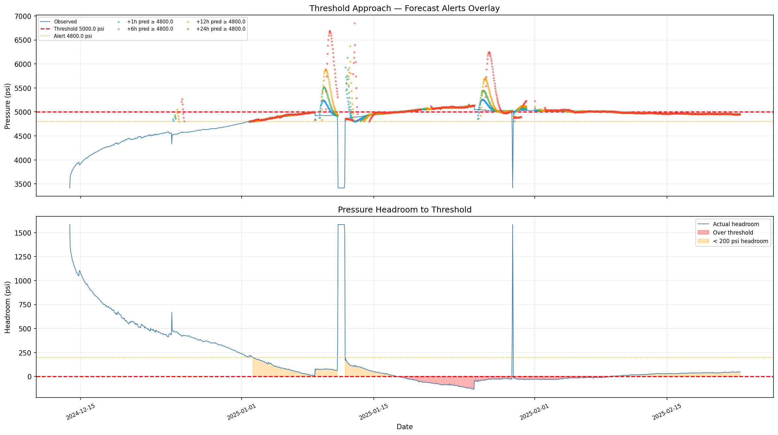
Backup Slides – Kalman Threshold Time Series

Slide 17
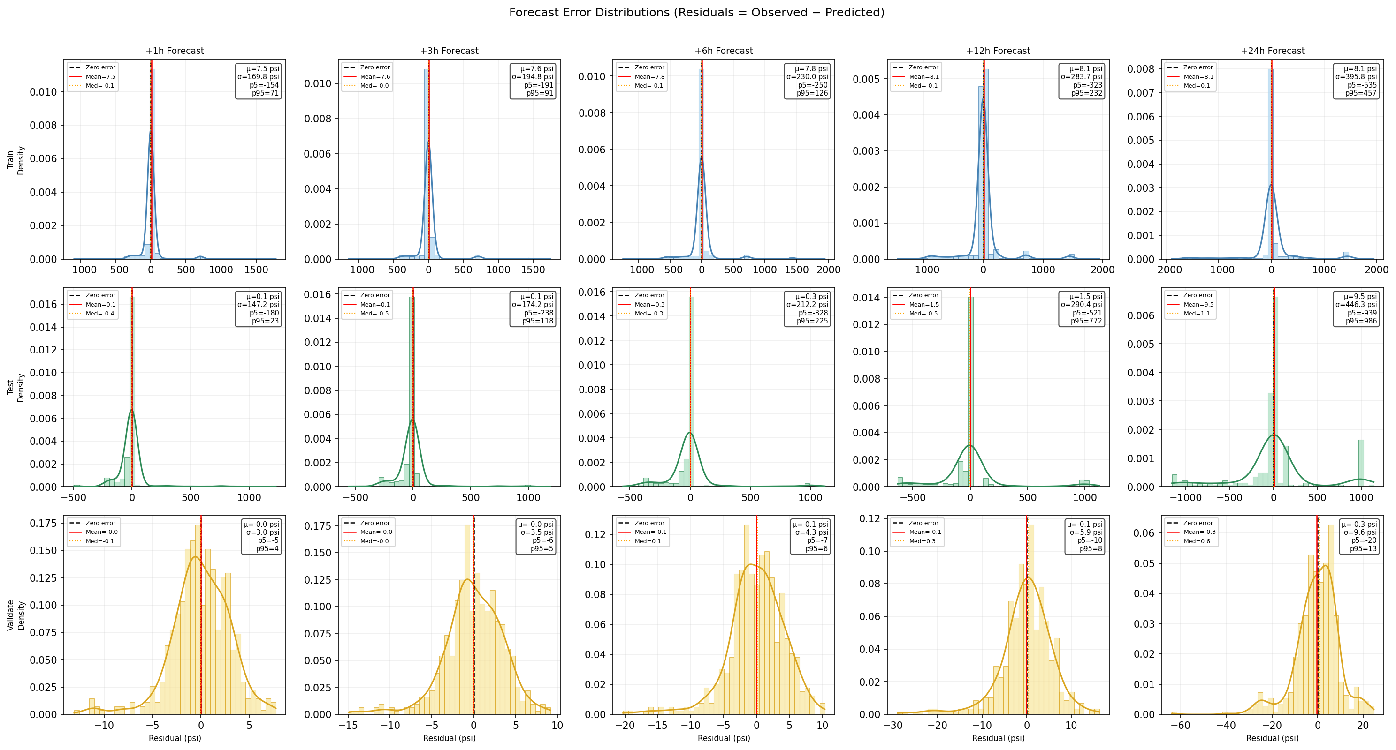
Backup Slides – Kalman Filter Error Distribution
Notes:
Note different magnitude of residuals per phase

Slide 18
Backup Slides – Kalman Confusion Matrices

Slide 19
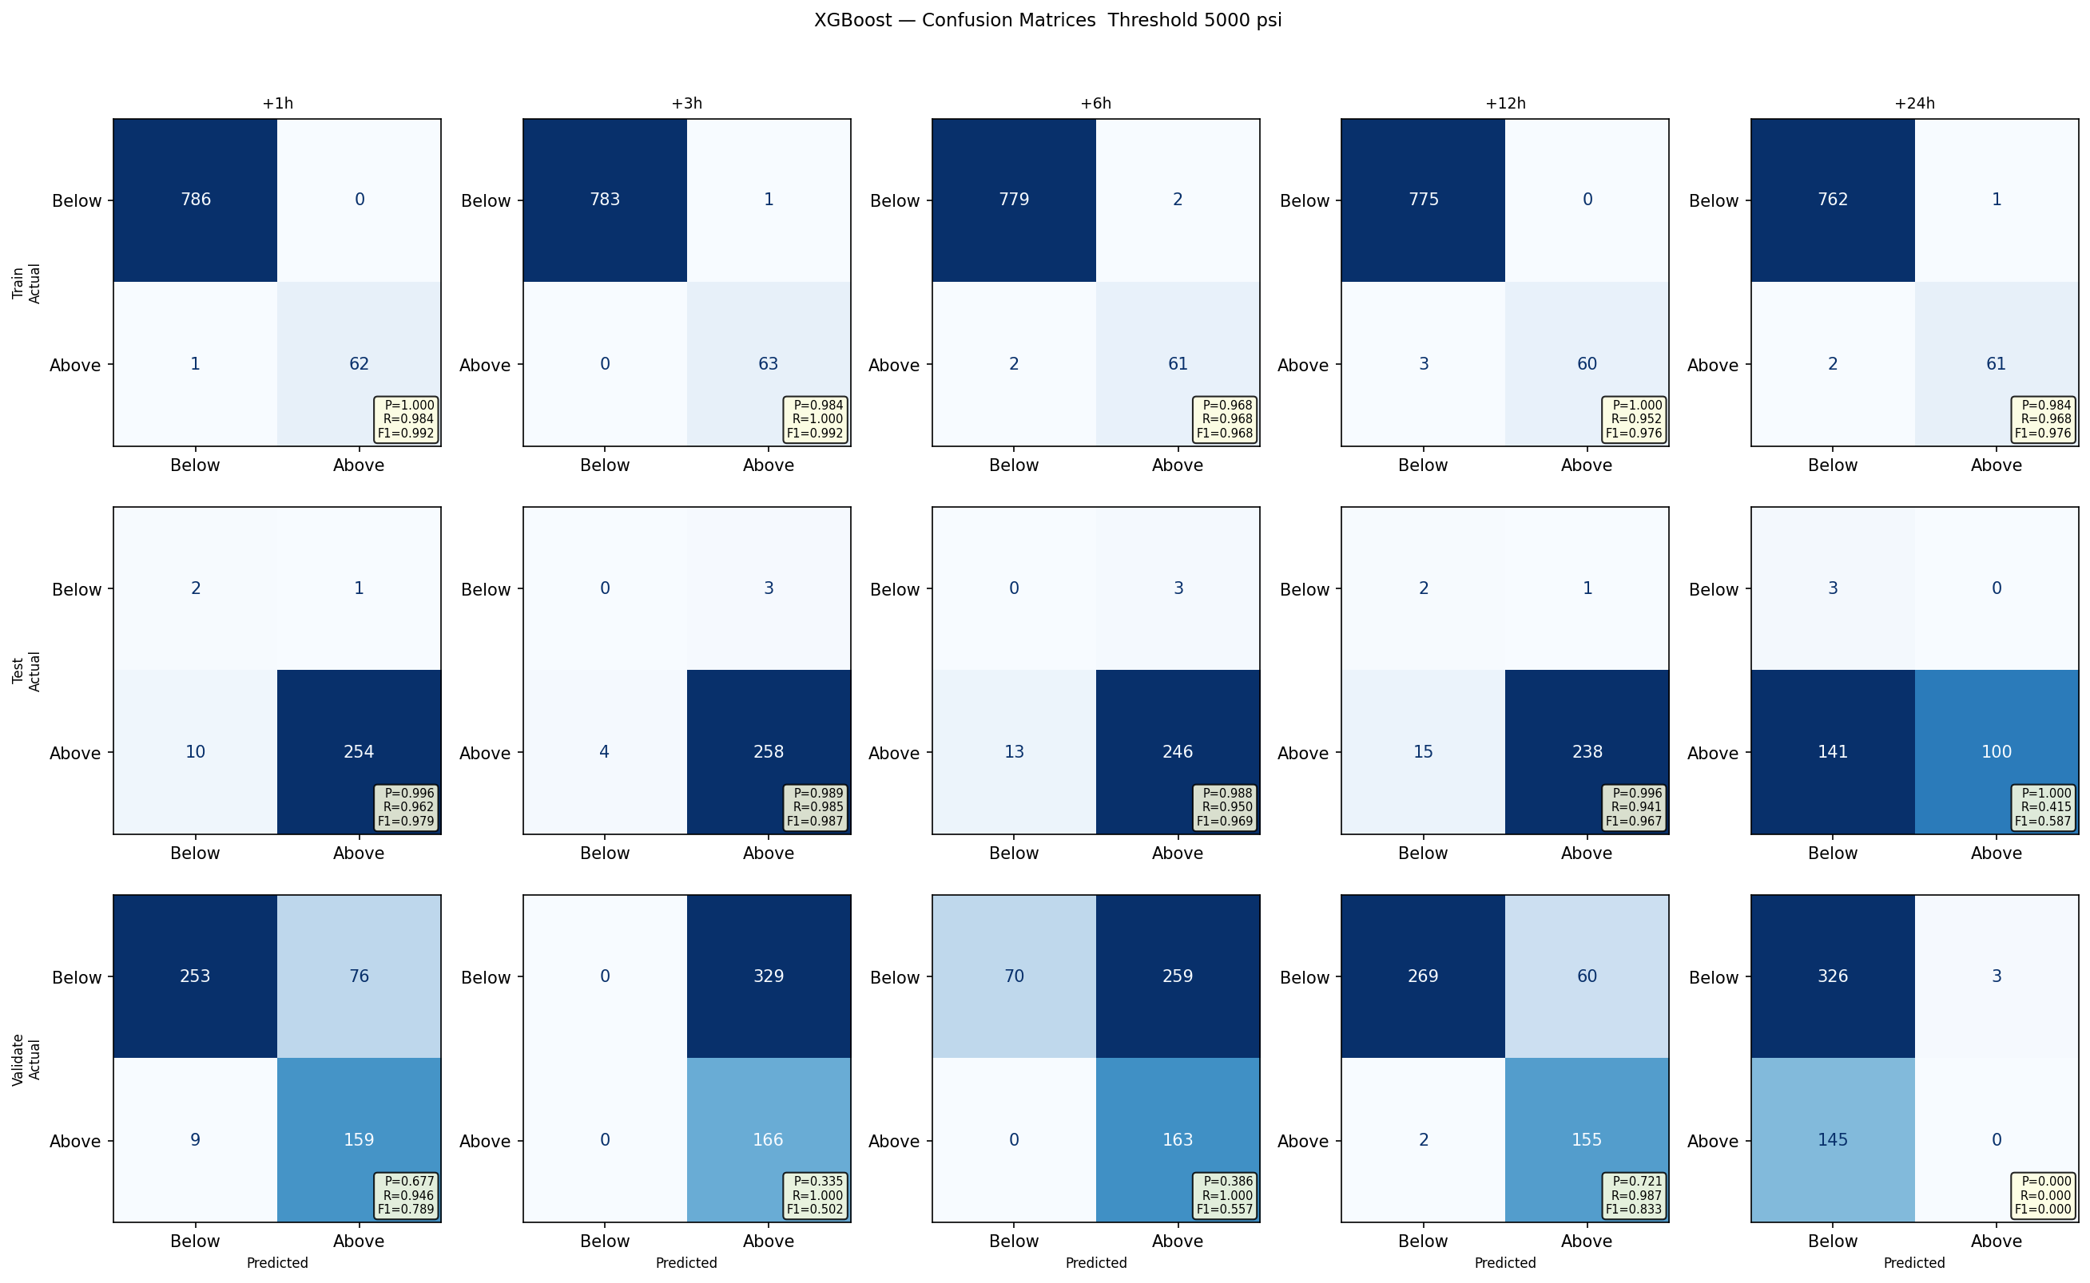
Backup Slides – XGBoost Confusion Matrices

Slide 20
Backup Slides – LSTM Confusion Matrices

Slide 21
Backup Slides – LLM Gemma3 Confusion Matrices
Notes:
Note: could also break this up by phase, but want each person discussing unique aspects they learned about or from in this project (e.g., how to prompt an LLM, what hyperparameters do for a model, etc.)

